Slide 1
Example 8.2.3(補充)
報告者:林威辰

Slide 2
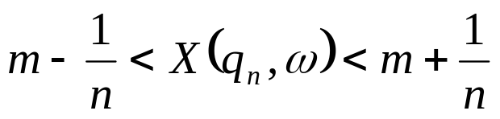
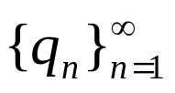


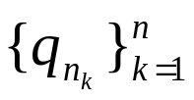
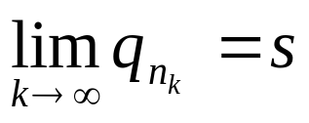
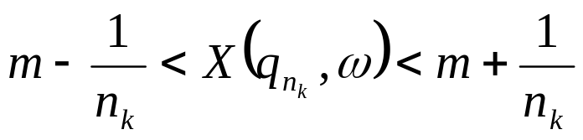



Problem
The infinite sequence must have an accumulation point s in the closed, bounded interval . In other words, there must exist a number and a subsequence such that .
Why use subsequence？

Slide 3


重要名詞解釋
Accumulation point Limit point
Closed point
Limit point：不允許 Sequence 內有與 Limit point 相同點。
Closed point ：可允許 Sequence 內有與Closed point相同點。

Slide 4

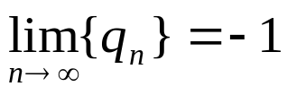


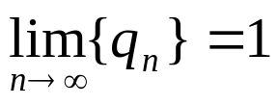

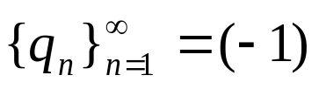


Example
Let sequence , and we know that
If n = odd, , that implies is closed point, not limit point.

Slide 5

Answer
We don’t know that converges or not?
We just know is bounded and countable.
Since is bounded, we need to use
Bolzano - Weierstrass Theorem.

Slide 6
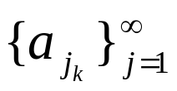
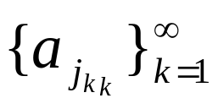
Bolzano-Weierstrass Theorem
Let be a sequence of real numbers that is bounded.
Then there exists a subsequence that converges.

Slide 7
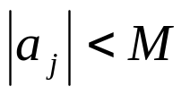




Proof of Bolzano-Weierstrass Theorem
Since the sequence is bounded, there exits a number M such that for all j.
Then
either or contains infinitely many element of the sequence.
Say that does. Choose one of them, and call it

Slide 8
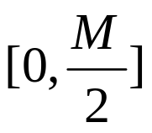
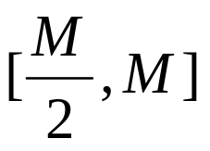


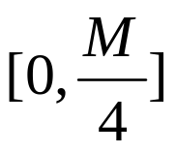
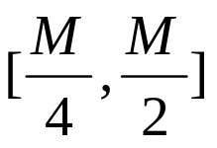
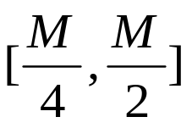

Proof of Bolzano-Weierstrass Theorem(續)
either or contains infinitely many element of the (original) sequence.
Say it is . Choose one of them, and call it .
either or contains infinitely many element of the (original) sequence.
Say it is . Choose one of them, and call it .

Slide 9
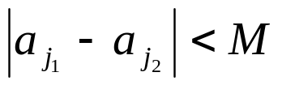
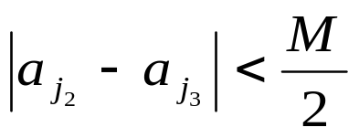
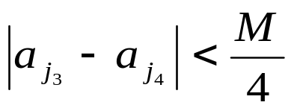

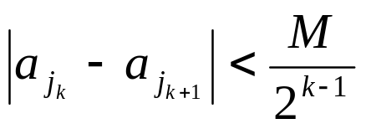
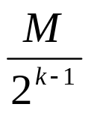
Proof of Bolzano-Weierstrass Theorem(續)
Keep on going in this way, halving each interval from the previous step at the next step, and choosing one element from that new interval. Here is what we get:
, because both are in .
, because both are in .
, because both are in .
and in general, we see that
because both are in an interval of length

Slide 10



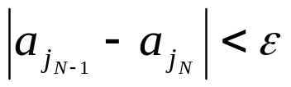
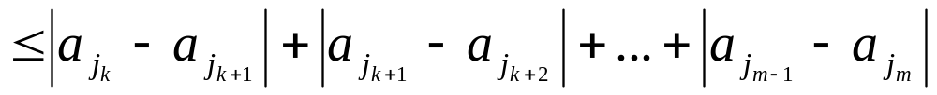
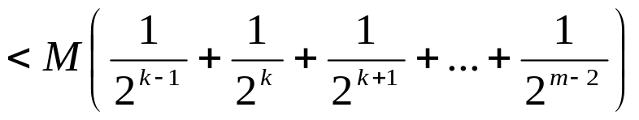
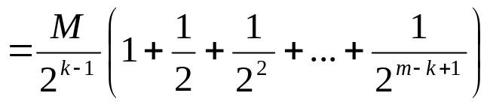
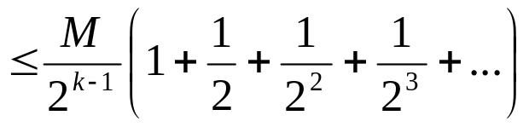
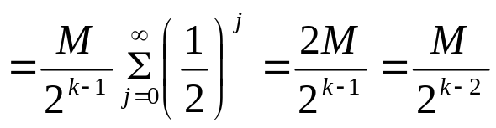
Proof of Bolzano-Weierstrass Theorem(續)
Take any , and pick an integer N such that
for any (with )
we have

Slide 11


Proof of Bolzano-Weierstrass Theorem(續)
We want to make N large enough, such that whenever , the difference between the members of the subsequence is less than the prescribed .

